Slide 1
CPHS Conf Figures
Created 4/16/2018
Updated 4/16/2018

Slide 2
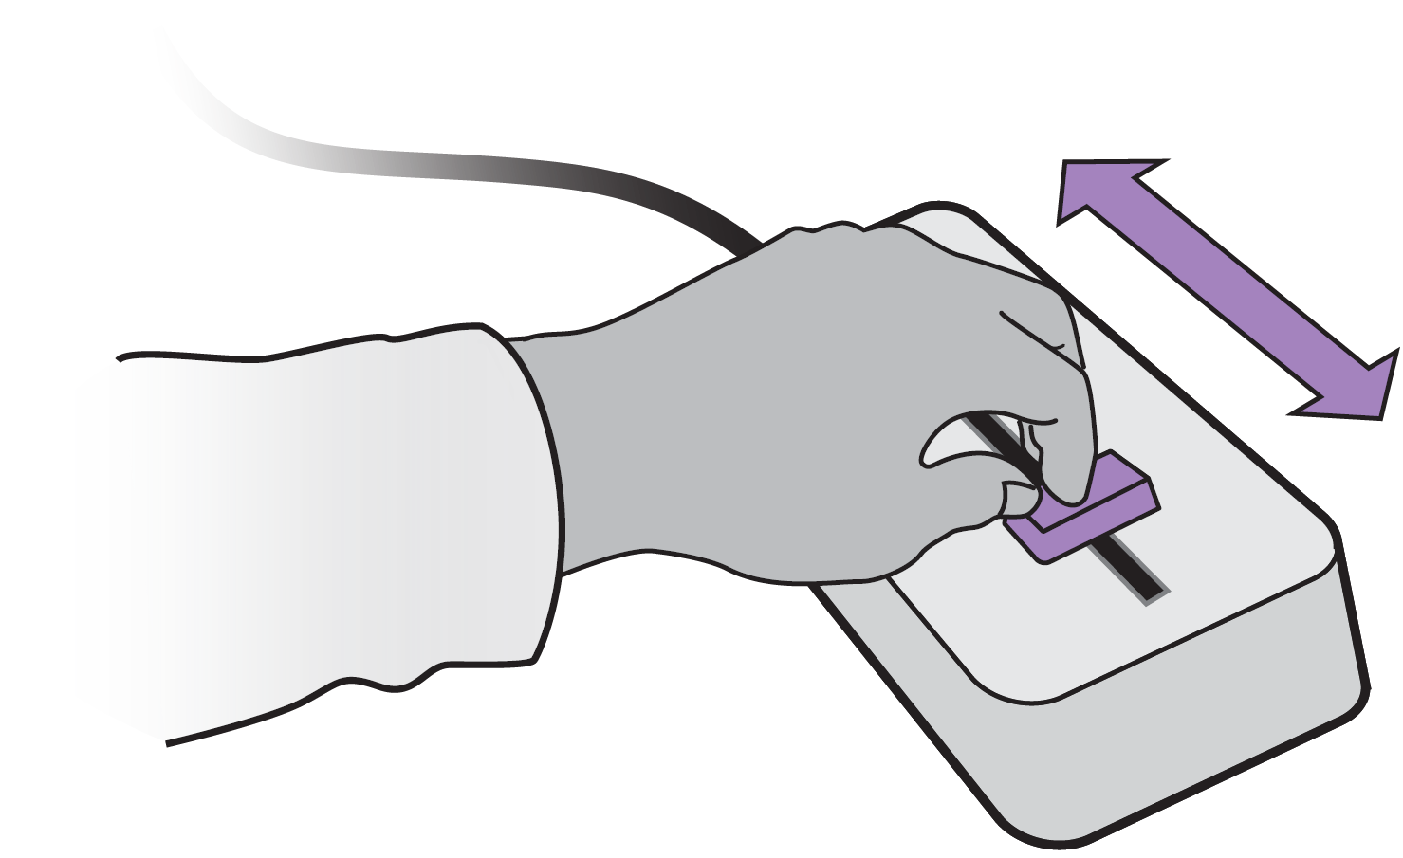
human
-cyber-physical system
a.
D
F
U
u
+
+
M
Y
R
+
B
-
b.
reference R
U
M
D
Y
Model M transforms user input U and disturbance D to output Y

Slide 3
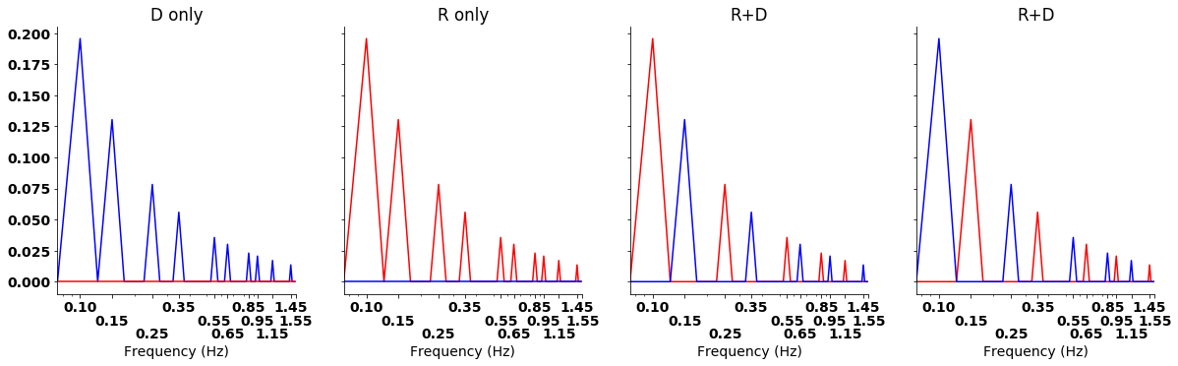

Slide 4
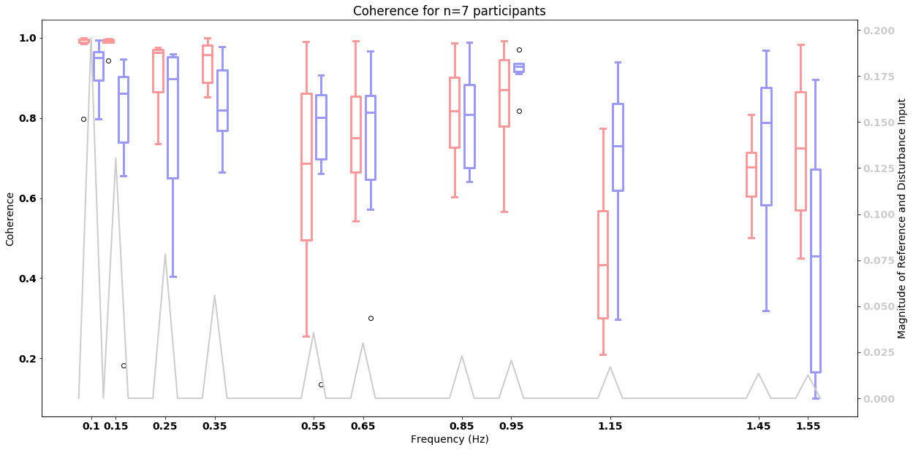
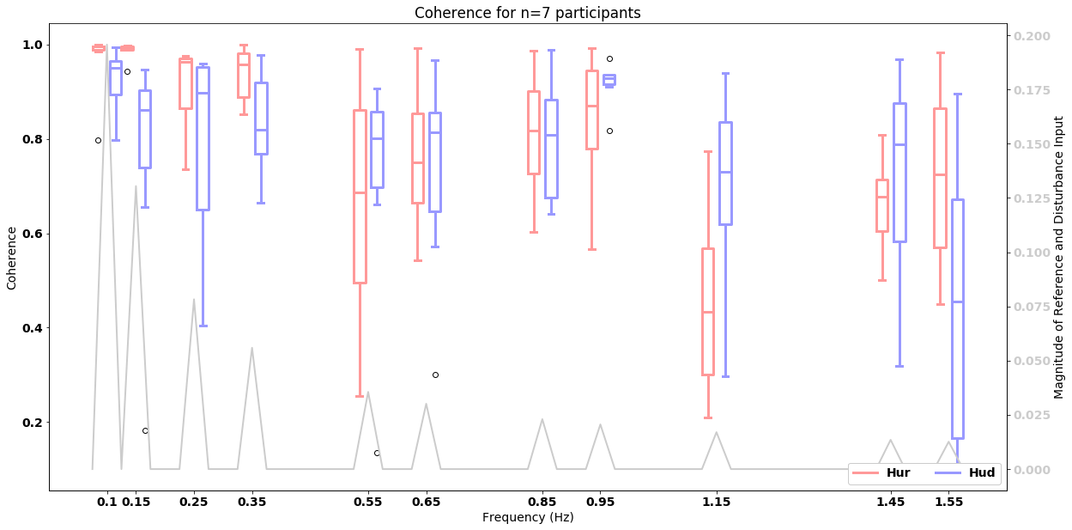

Slide 5
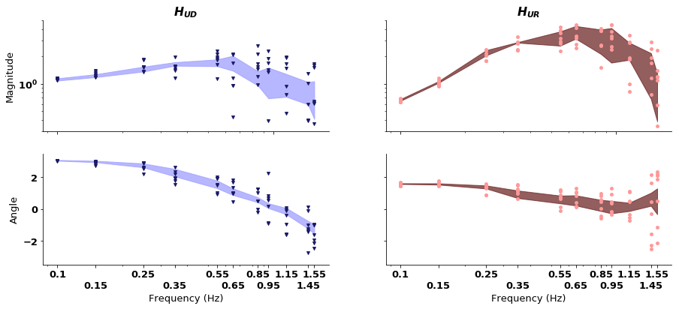

Slide 6
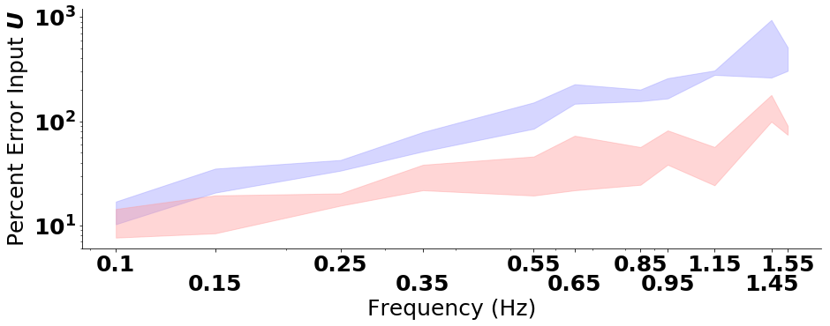

Slide 7
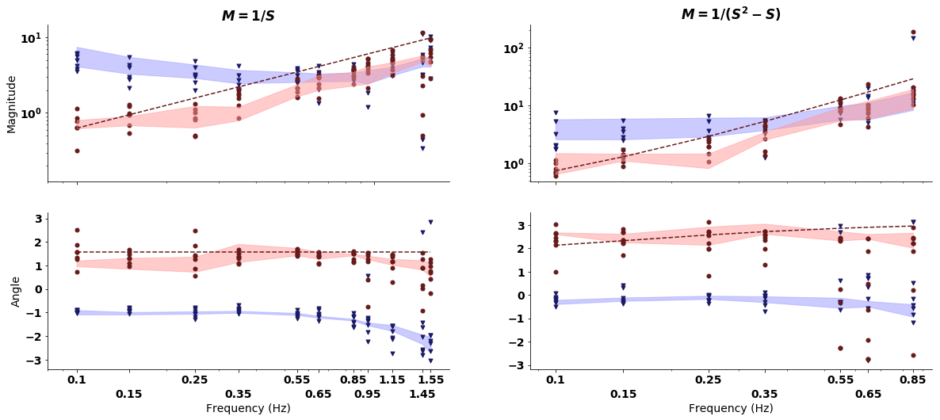
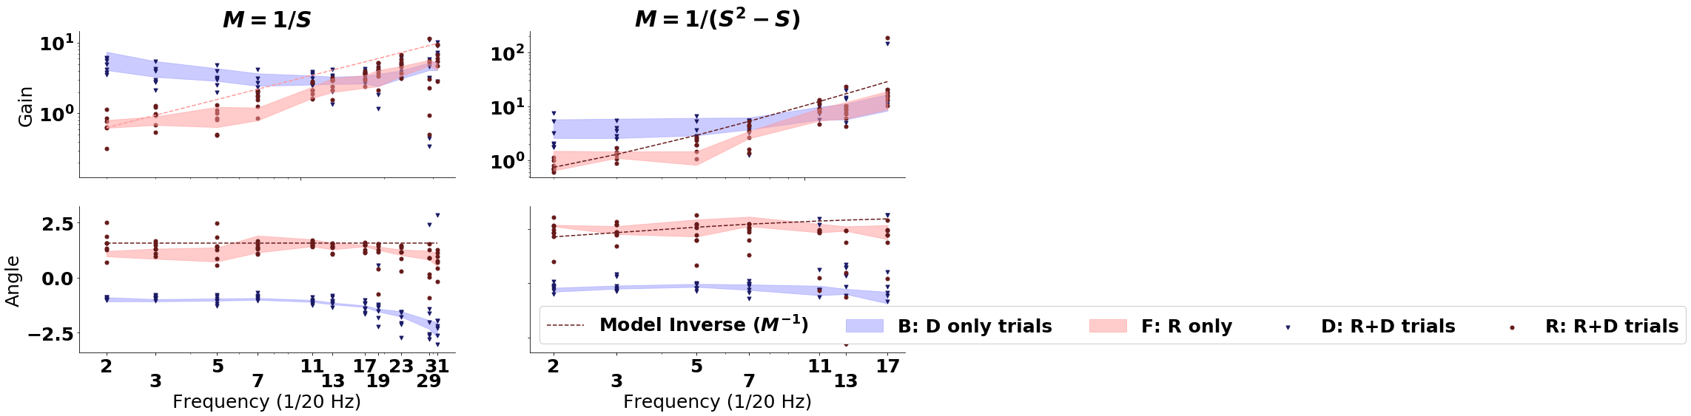

Slide 9
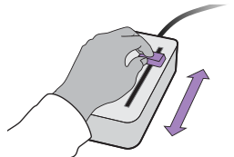

a)
reference r
user input u
+ disturbance d
b)
output y
human
-cyber-physical system
D
F
u
+
+
M
Y
E
R
+
B
-

Slide 10
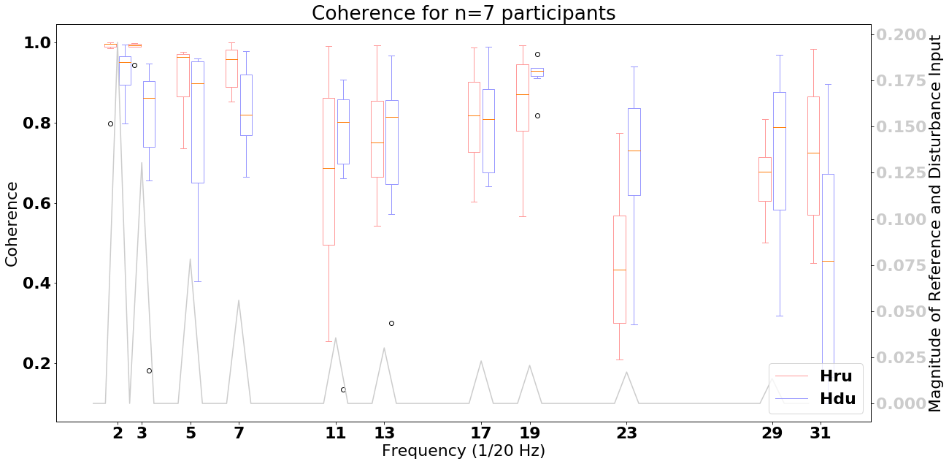
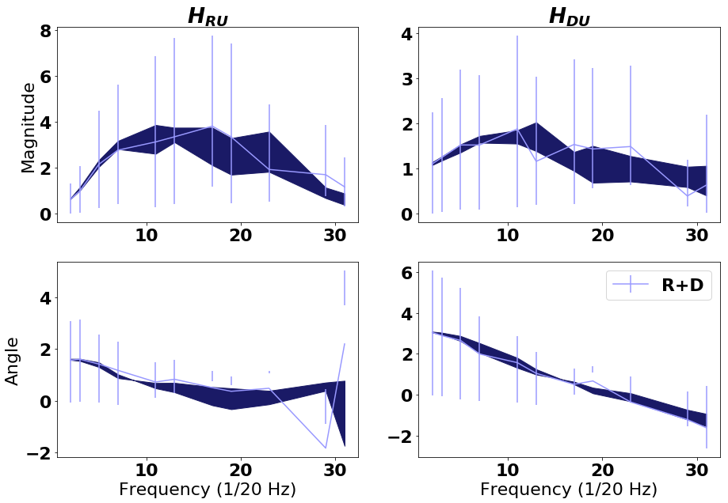
a)
b)
c)

Slide 11
